Slide 1
Welcome to the Party
Making introductions in Frank O’Hara’s Lunch Poems

Slide 2
Frank O’Hara and Lunch Poems

Slide 3
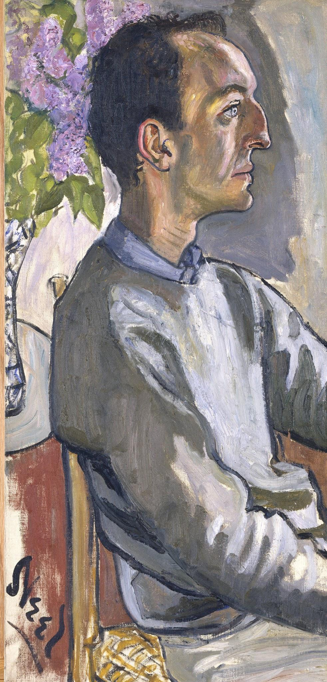
Frank O’Hara
Frank O’Hara (1926-1966) was an important figure in New York’s poetry and art scene in the 1950s and 1960s. He was friends with poets who would later become influential (John Ashbery, Allen Ginsberg, Amiri Baraka), and, despite his untimely death, his own work would also influence generations of poets.
In addition to his influence in the avant-garde poetry world, O’Hara was also deeply connected to the world of fine art. He worked in various capacities at the Museum of Modern Art, and was friends with many of the major figures in the abstract expressionist movement.
Frank O’Hara by Alice Neel, 1960. Oil on canvas (85.7 x 40.6 x 2.5 cm). Gift of Hartley S. Neel. National Portrait Gallery, Smithsonian Institution.

Slide 4
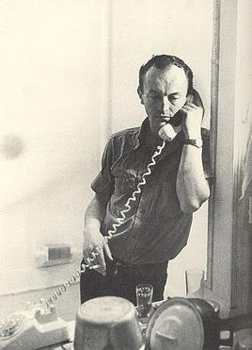
Poetics: Personism
Personism, a movement which I recently founded and which nobody yet knows about, interests me a great deal, being so totally opposed to this kind of abstract removal that it is verging on a true abstraction for the first time, really, in the history of poetry....If I wanted to I could use the telephone instead of writing the poem... It puts the poem squarely between the poet and the person, Lucky Pierre style, and the poem is correspondingly gratified. The poem is at last between two persons instead of two pages.
Photograph by Mario Schifano, 1965

Slide 5
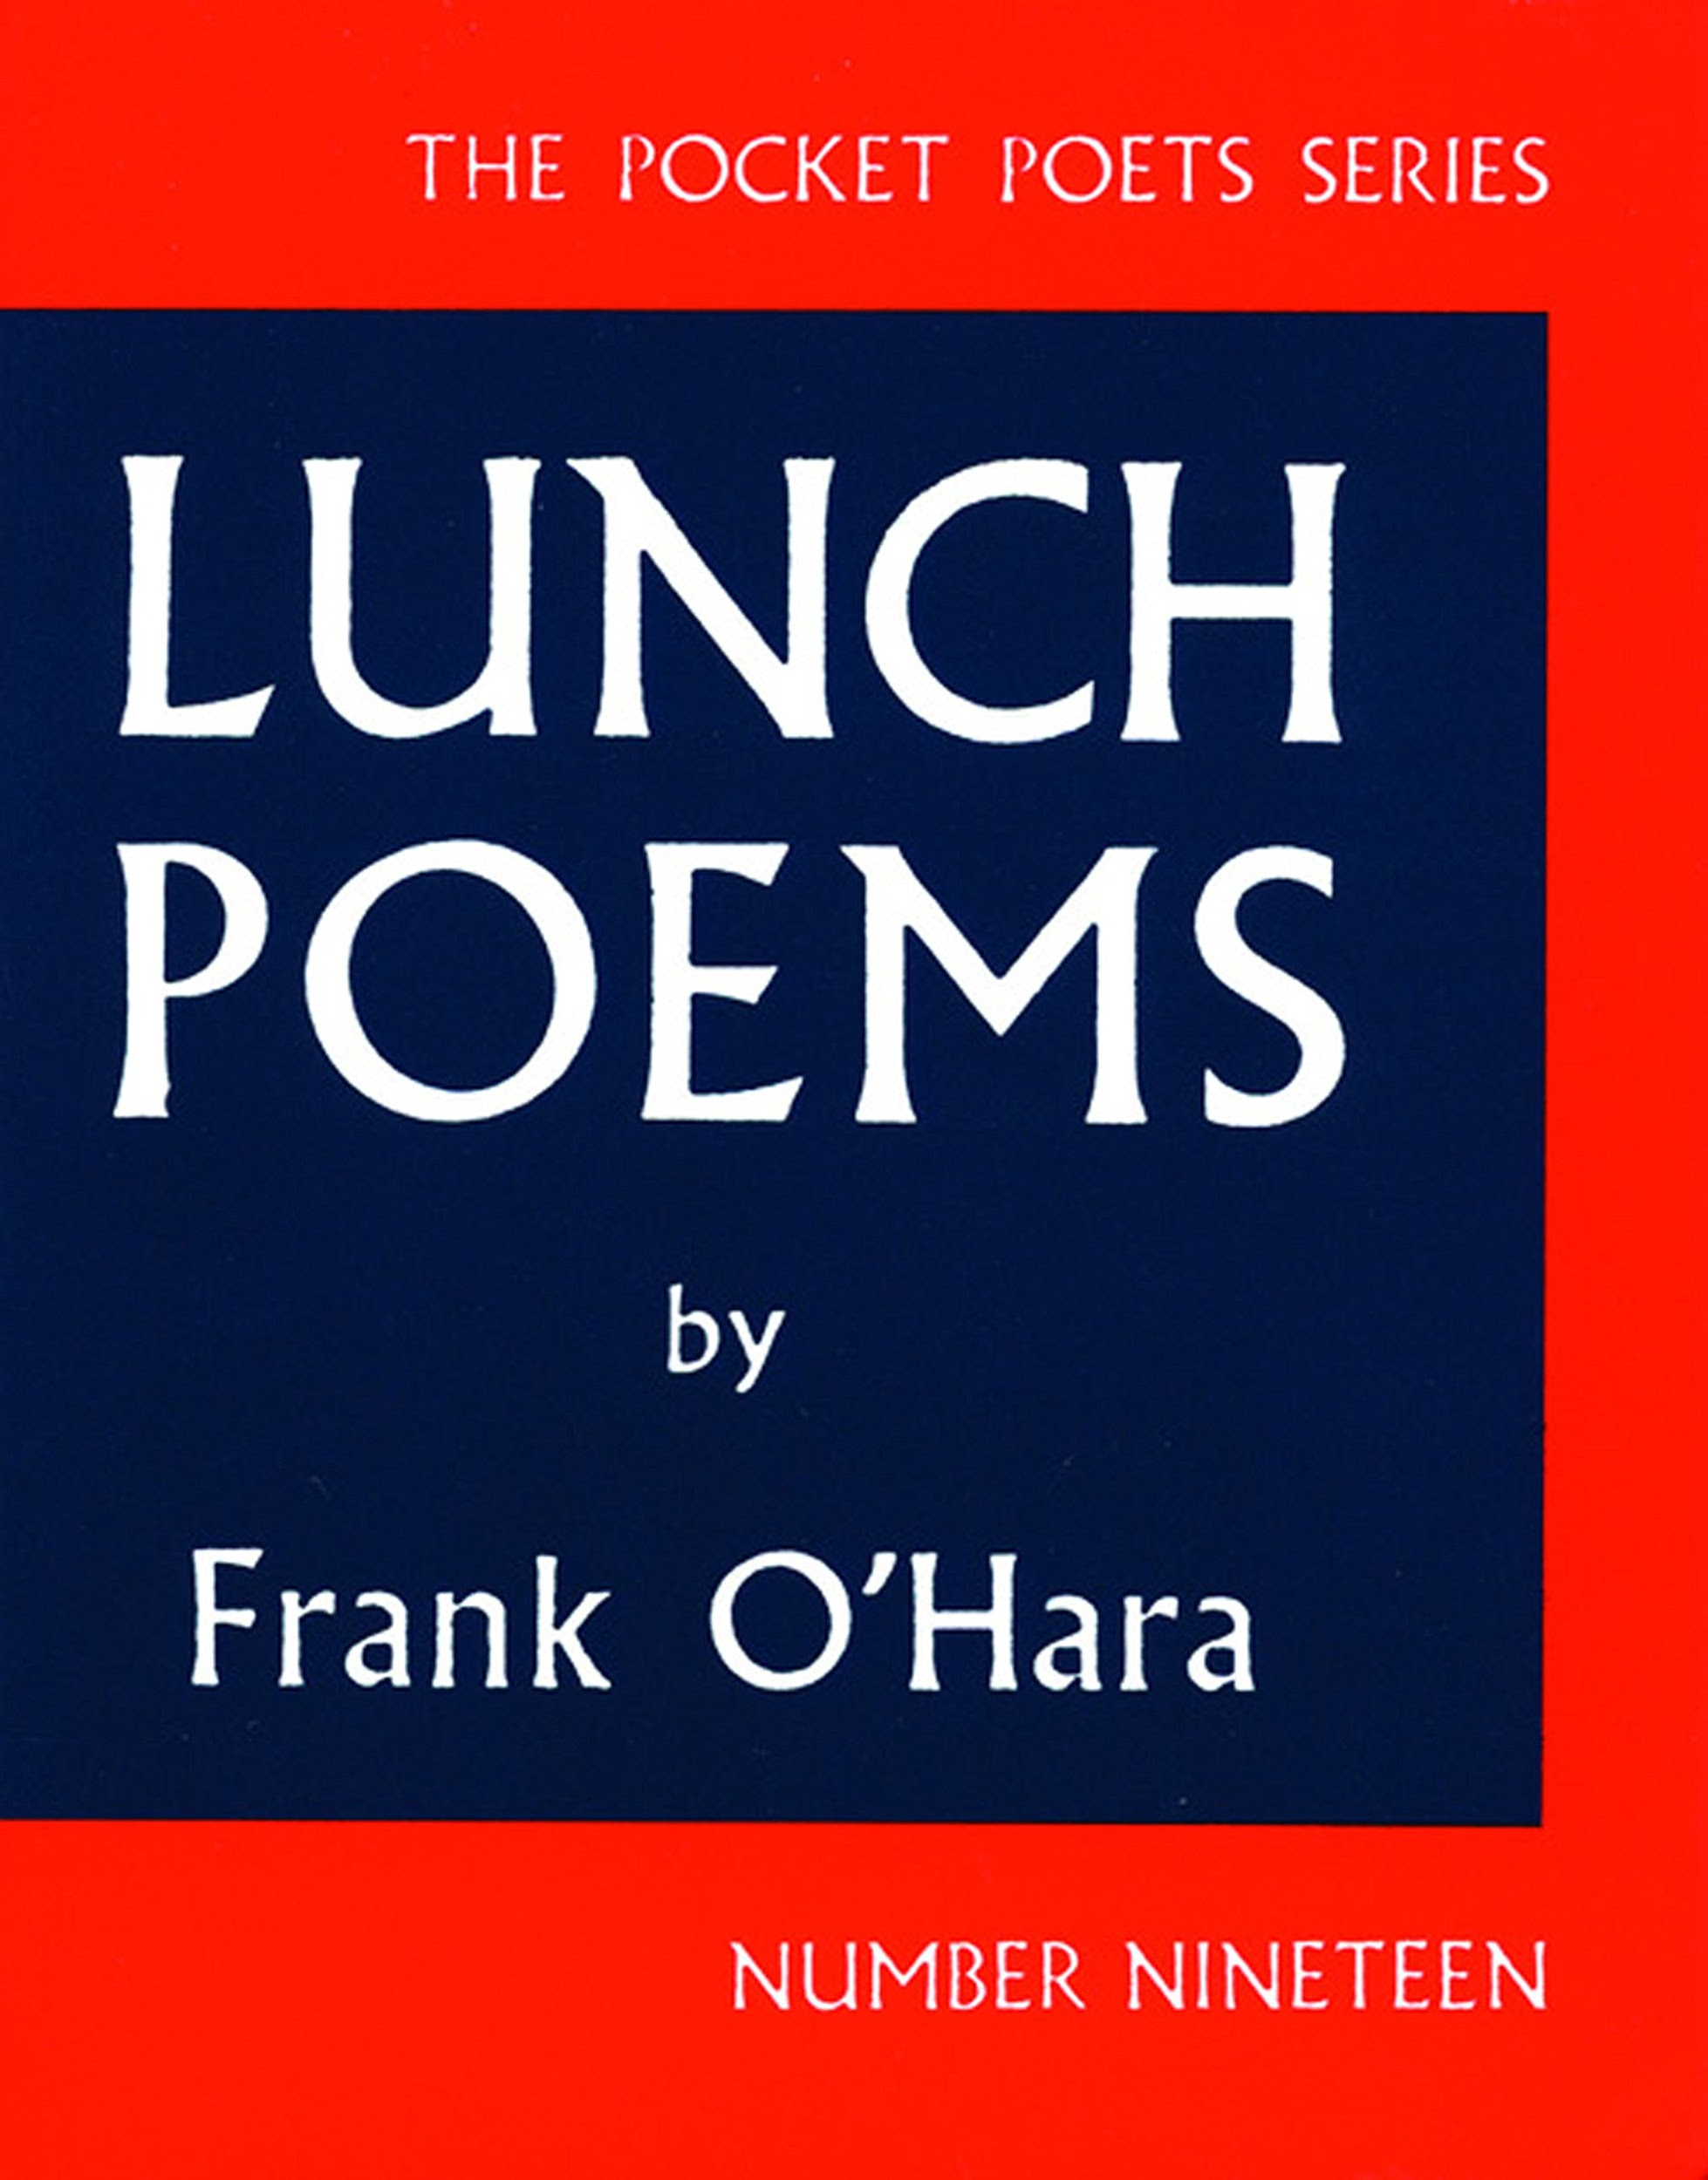
Lunch Poems
O’Hara’s best known and most influential work, Lunch Poems was published in 1965, and collects poems written between 1953 and 1965.

Slide 6
Lunch Poems
O’Hara’s best known and most influential work, Lunch Poems was published in 1965, and collects poems written between 1953 and 1965.
Included are several of O’Hara’s best known poems including “A Step Away from Them,” “The Day Lady Died” and [Lana Turner has collapsed!]

Slide 7
Constructing a Digital Edition

Slide 8
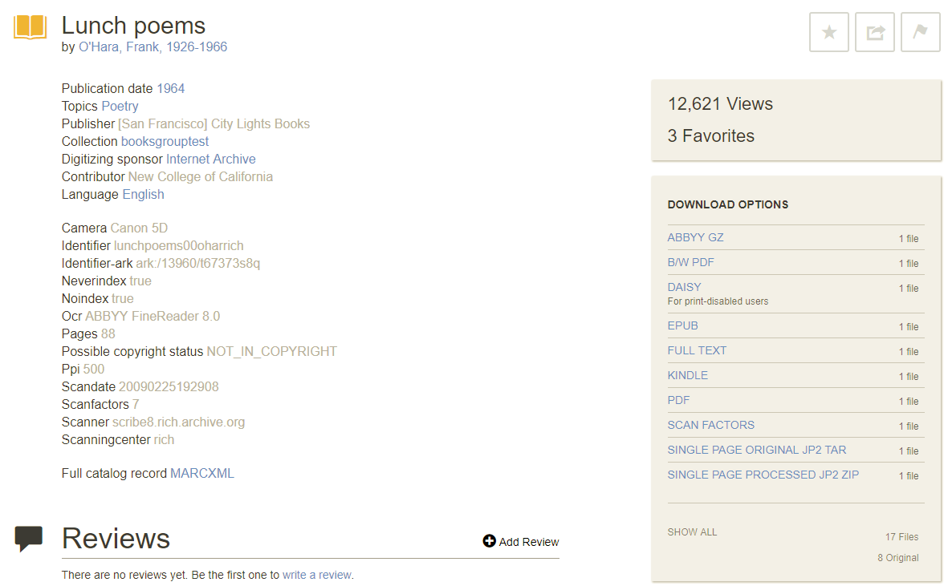
Constructing A Digital Edition
Lunch Poems already exists digitally in several different formats. For this project I began with an EPUB hosted on the Internet Archive.

Slide 9
XSLT: From EPUB to TEI
Issues:
Unhelpful HTML structure
Badly OCRed text

Slide 10
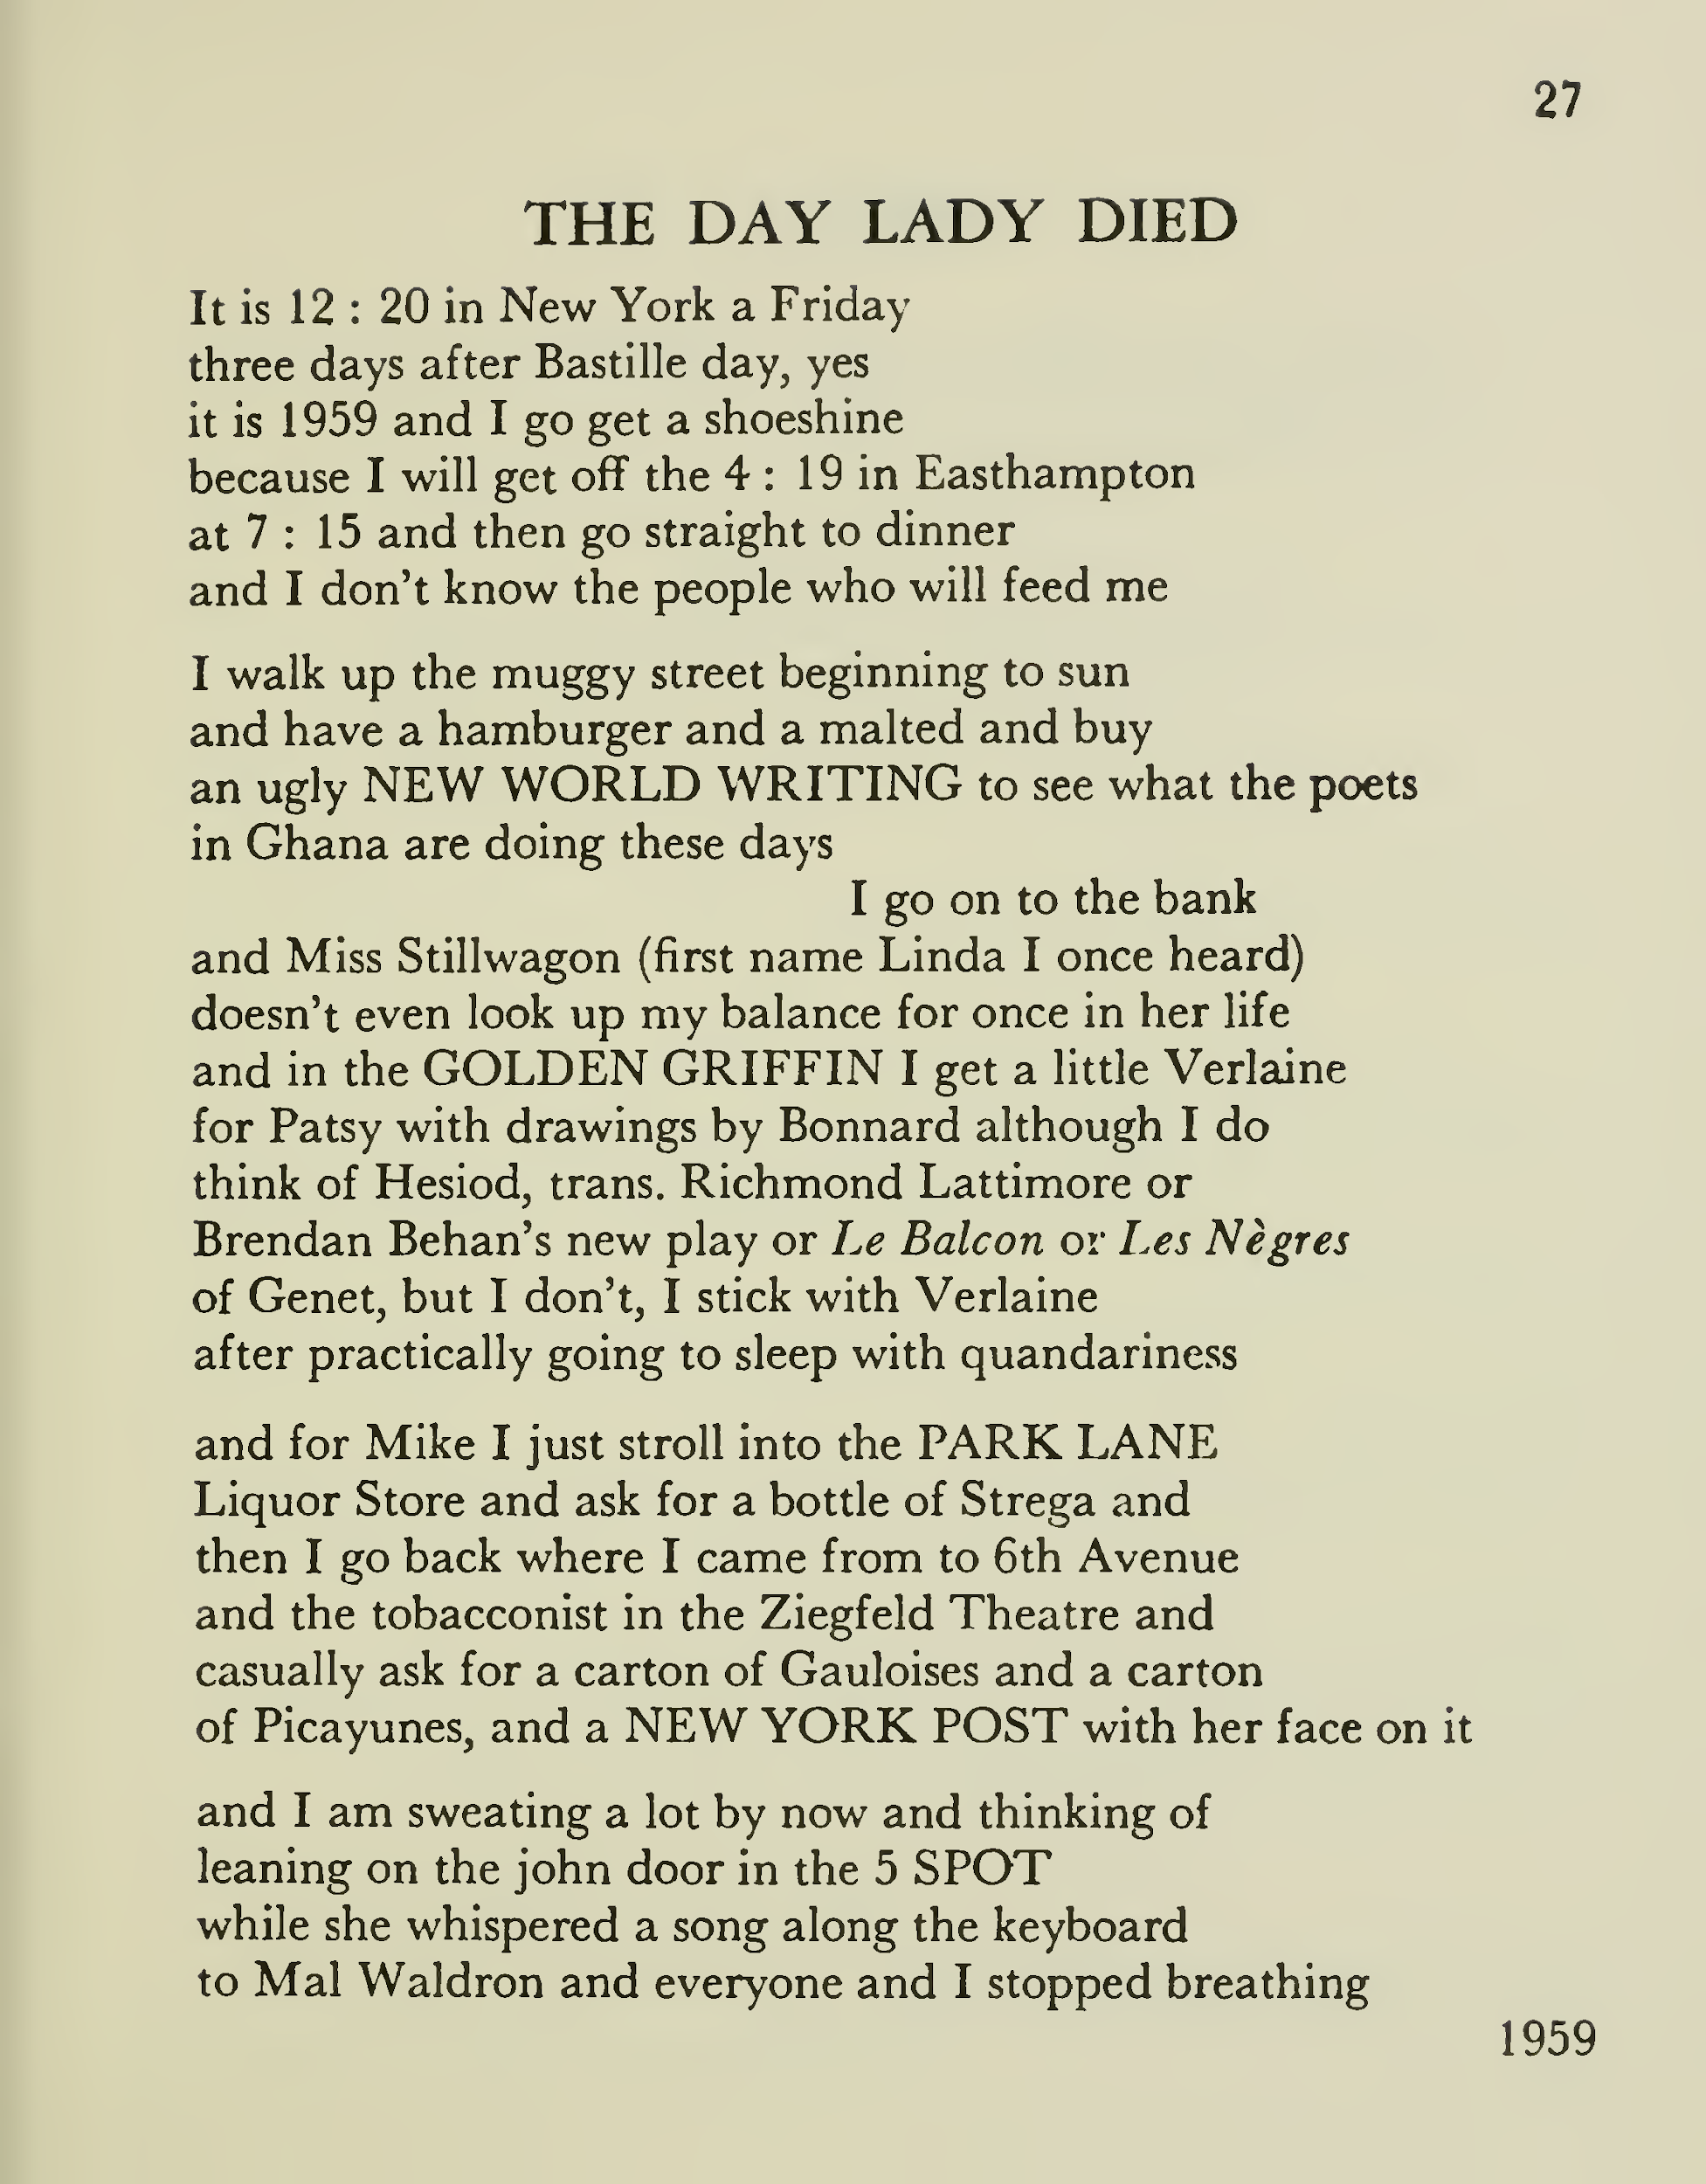
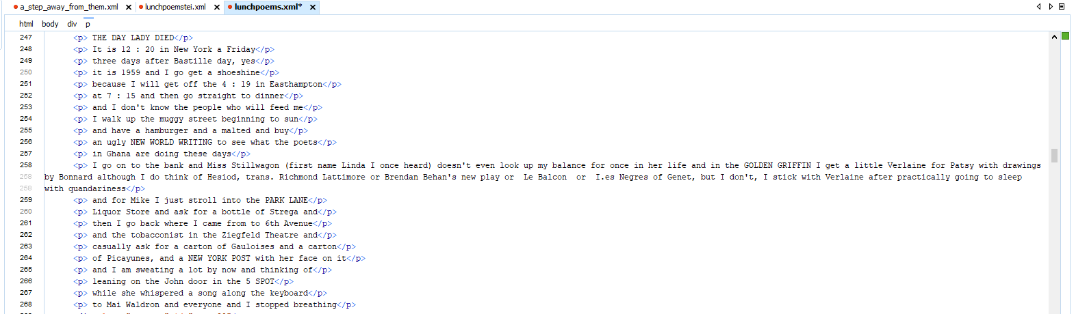
XSLT: From EPUB to TEI

Slide 11
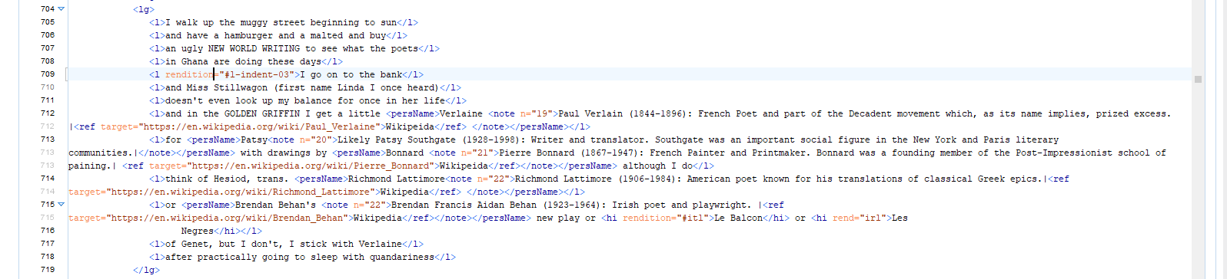
Annotation

Slide 12
